Slide 1
Classification and update of Land Use data: a multi-source and multi-modal machine learning approach
Martin CUBAUD
PhD director: Ana-Maria OLTEANU-RAIMOND
Supervisors: Arnaud LE BRIS, Laurence JOLIVET
Reviewer: Alexis COMBER, Professor, School of Geography, University of Leeds
Reviewer: Alexander ZIPF, Professor, Heidelberg Institute for Geoinformation Technology
Examiner: Cidália FONTE, Professor, University of Coimbra, INESC Coimbra
Examiner: David SHEEREN, Professor, INP-ENSAT, UMR 1201 Dynafor
January 16th, 2026
Notes:
Good afternoon. Dear members of the jury, thank you for attending at my phd defense entitled …

Slide 2
Introduction
Introduction
State of the art
LU classification
LU change detection
Conclusion

Slide 3
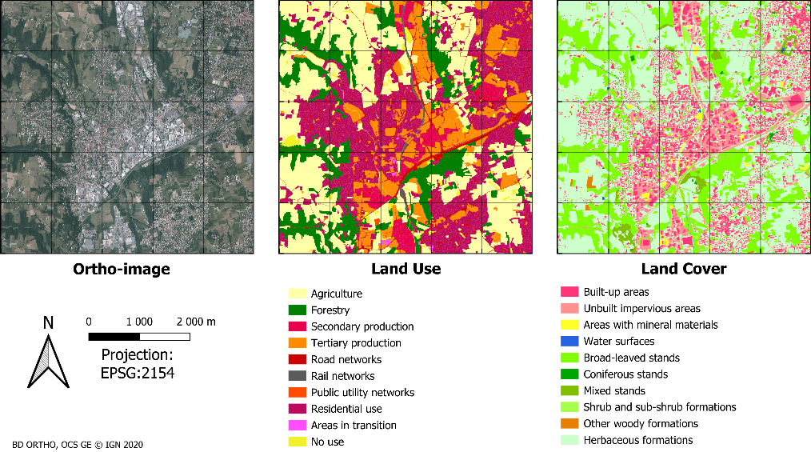
Context
Introduction
State of the art
LU classification
LU change detection
Conclusion
Notes:
The context of this research work is the need of accurate and up-to-date LU data. These data describes the socio-economic human activities in a given territory, with classes such as agriculture or residential

Slide 4

Context
Introduction
State of the art
LU classification
LU change detection
Conclusion
Notes:
Alongside with LC data which is a physical description of the territory, with classes such as built-up or vegetation

Slide 5

Role of LU and LC data
Introduction
State of the art
LU classification
LU change detection
Conclusion
©sdg.un.org
Notes:
LU and LC data are used to support several united nation sustainable development goals, such as

Slide 6

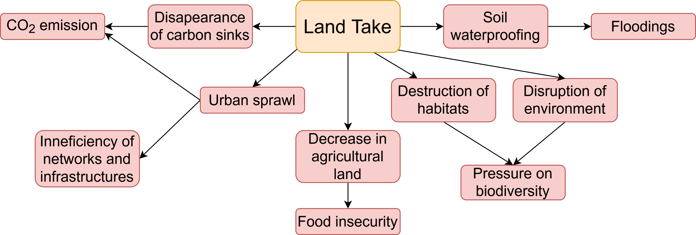



Role of LU and LC data: example of land take
Introduction
State of the art
LU classification
LU change detection
Conclusion
Objective of zero net land take by 2050 (EU soil strategy, "ZAN" law in 2021)
LULC data
Both LU and LC are needed
Monitoring the evolution and assessing the impact
Defining and monitoring urban planning policies
Bocquet (2023)
Notes:
For instance, a key role of LULC data is related to the mitigation of Land take. Land Take has several negative impacts on CO2…

Slide 7


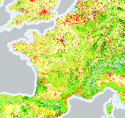
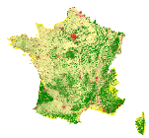
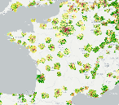

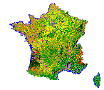
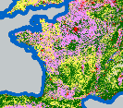
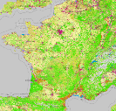

Examples of LULC products
Introduction
State of the art
LU classification
LU change detection
Conclusion
Global dynamic Land Cover 11 LC classes Resolution: 10m Automatic
Every year
🧪
CORINE Land Cover
44 LULC classes
MMU: 25 ha
Semi-automatic
Every 6 years
Urban Atlas 27 LULC classes MMU: 0.25 ha to 1 ha
Semi-automatic
Every 6 years
OSMLanduse Schultz et al. (2025) 13 LULC classes Resolution: 10m or <1m Automatic
EU/Global
1990
2006
2013
2018
2020
2020
OCS GE (IGN) 14 LC x 20 LU classes MMU: 0.05 ha to 0.25 ha
Semi-automatic
Every 3 years
🧪
Separation of LU and LC
INSPIRE directive (2007)
Theia OSO Inglada et al. (2018)
24 (mostly) LC classes Resolution: 10m raster
Automatic
Every year
France
→ Automatic
🧪: Research product
→ 1
Notes:
And so, several LULC products have been proposed through the years. For example
Overall, this timeline shows an evolution towards higher resolution, more frequent update thanks to automatization
Among these products

Slide 8
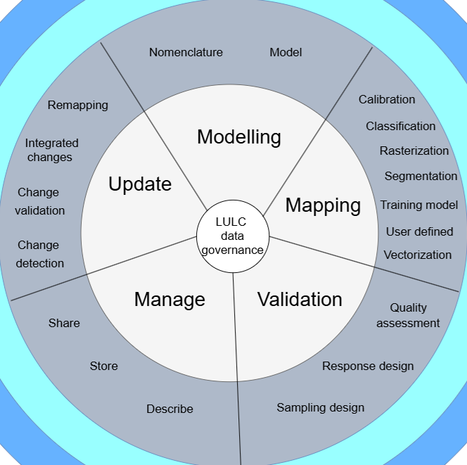
Life cycle of LULC data
Introduction
State of the art
LU classification
LU change detection
Conclusion
Five main processes in the life cycle of LULC data (OntoLULC-SOTA ontology)
Two challenging subprocesses for LU:
Automatic LU classification
Automatic LU change detection
Management
Cubaud et al. (submitted)
Notes:
These LULC products have a life cycle, composed of 5 main processes that were defined in a collaborative ontology research work on LULC in which I participated in the design and instantiation. These five main processes are: We identified…

Slide 9
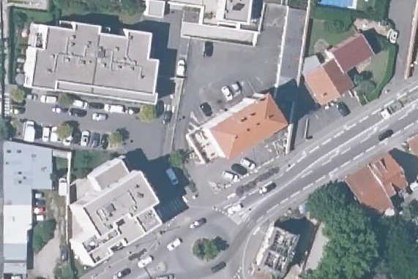
Challenge of LU classification
Introduction
State of the art
LU classification
LU change detection
Conclusion
Automatic Land Cover thanks to progress in deep learning (Ma et al., 2019)
Land Use cannot be determined from remote sensing data only (Comber et al., 2005)
Land Cover:
Built-up
Land Cover:
Built-up
Land Use:
Residential
Land Use:
Tertiary production
BD ORTHO © IGN 2020

Slide 10
Objectives
Introduction
State of the art
LU classification
LU change detection
Conclusion
Automatic LU change detection
Automatic LU classification
To produce LU maps
To update LU maps

Slide 11
Outline
Introduction
State of the art
LU classification
LU change detection
Conclusion
Introduction
State of the art
Land Use classification
Land Use change detection
Conclusion

Slide 12
State of the art
Introduction
State of the art
LU classification
LU change detection
Conclusion

Slide 13
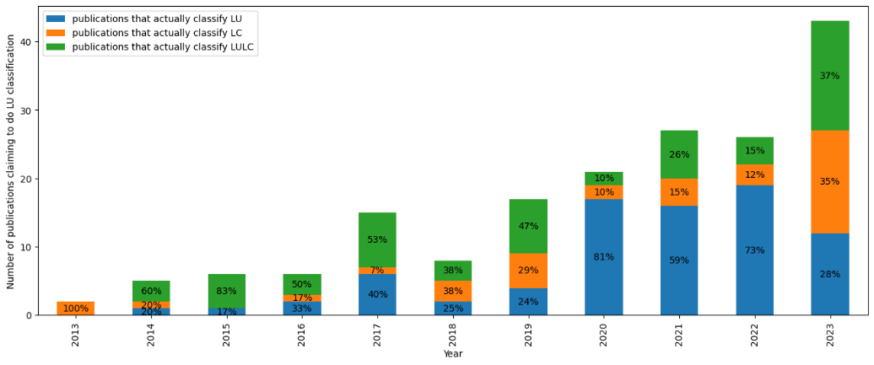
Confusion between Land Use and Land Cover
Introduction
State of the art
LU classification
LU change detection
Conclusion
Among 361 LU classification articles (systematic analysis 2013 to 2023)
21% of them actually classify Land Cover
33% of them mix in their nomenclature LU and LC classes.

Slide 14
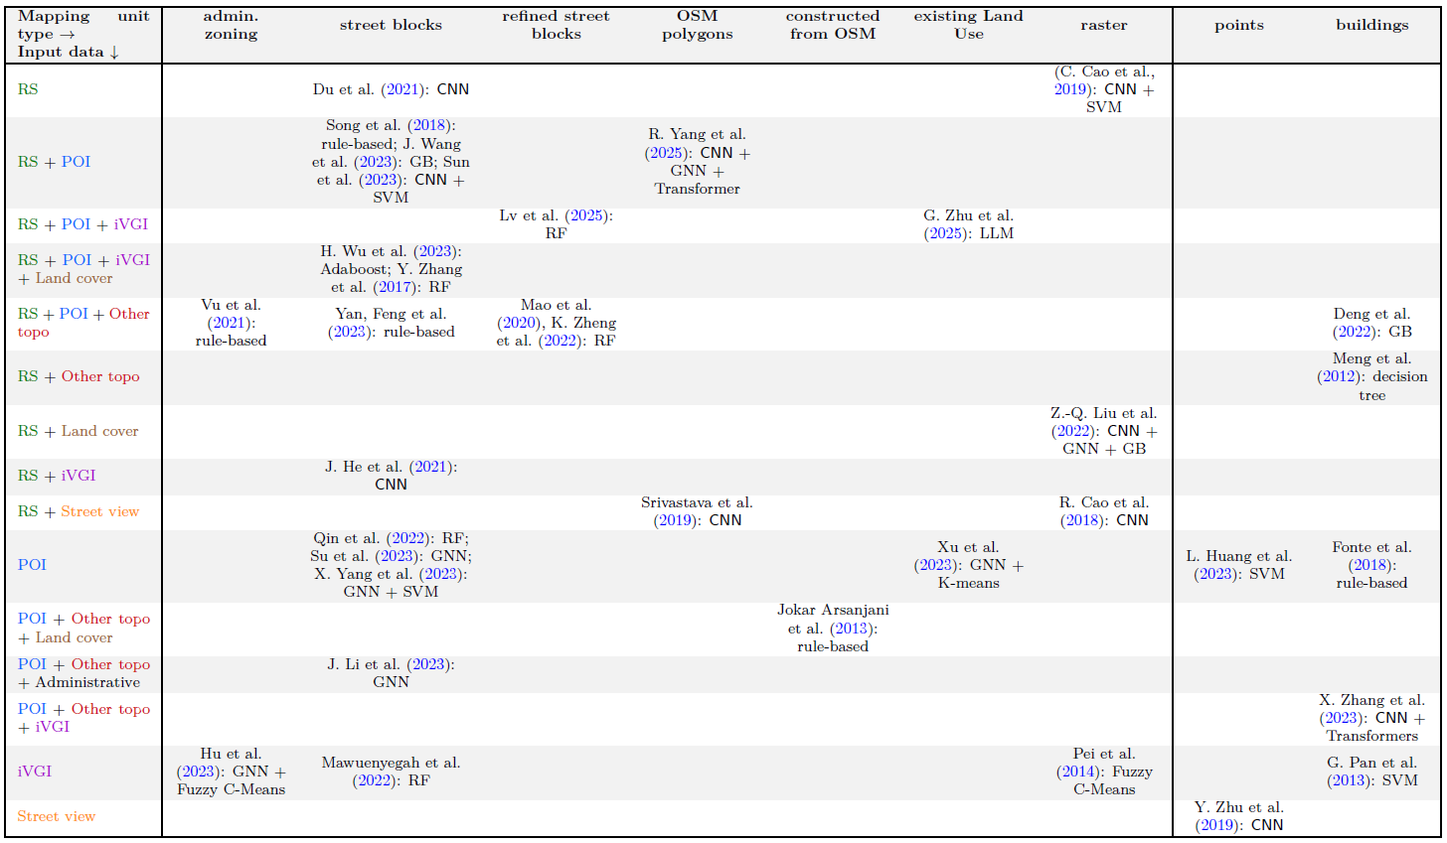
State of the art – LU classification
Introduction
State of the art
LU classification
LU change detection
Conclusion
On actual LU classification articles
Focus on 3 aspects:
Input data sources
Mapping units
Methods

Slide 15
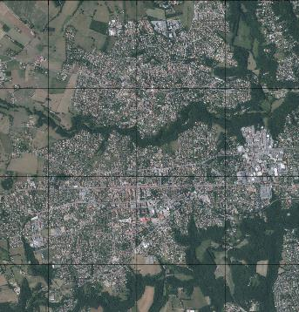
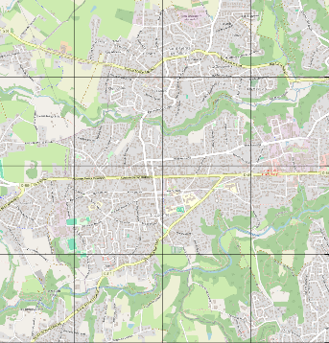

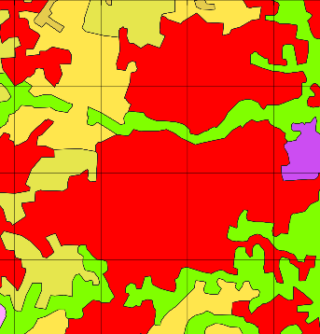
State of the art – LU classification
Introduction
State of the art
LU classification
LU change detection
Conclusion
Use of a wide variety of:
Data sources:
Remote sensing imagery
Points of Interest
Topographic data
Land Cover data
…
©BD Ortho
©BD TOPO
©OSM
The use of several data sources improves the classification
©CLC

Slide 16
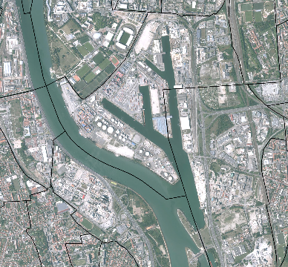
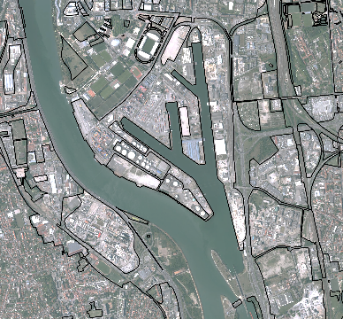
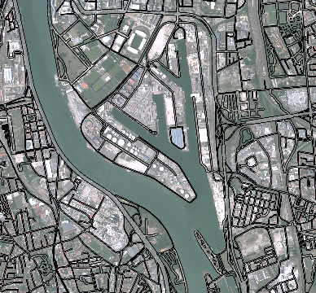
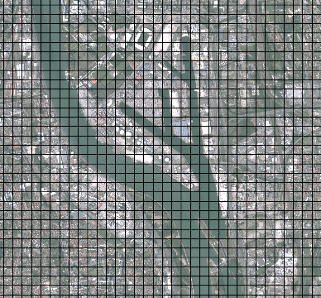
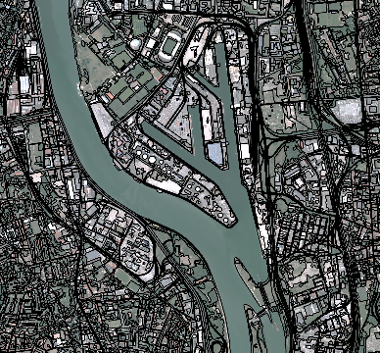
State of the art – LU classification
Use of a wide variety of:
Data sources
Types of mapping unit
Administrative Zoning
OSM Landuse polygons
Blocks from roads
Raster grids
Existing LU maps
Du et al. (2021), Song et al. (2018), Wang et al. (2023), Sun et al. (2023), Wu et al. (2023), Zhang et al. (2017), Feng et al. (2023), He et al. (2021), Qin et al. (2022), Su et al. (2023), Yang et al. (2023), Li et al. (2023), Mawuenyegah et al. (2022)
Vu et al. (2021), Hu et al. (2023)
R. Yang et al. (2025), Srivastava et al. (2019)
C. Cao et al. (2019), Liu et al. (2022), R. Cao et al. (2018), Pei et al. (2014)
G. Zhu et al. (2025), Xu et al. (2023)

Slide 17
State of the art – LU classification
Introduction
State of the art
LU classification
LU change detection
Conclusion
Use of a wide variety of:
Data sources
Types of mapping unit
Classification methods:
Rule-based approaches: Jokar Arsanjani et al. (2013), Fonte et al. 2018), Song et al. (2018), Vu et al. (2021), Feng et al. (2023)
Unsupervised classification (K-means, fuzzy C-means): Pei et al. (2014), Hu et al. (2023), Xu et al. (2023)
Supervised classification (SVM, RF, GB, CNN, GNN, Transformers): Pan et al. (2013), Zhang et al. (2017), R. Cao et al. (2018), Srivastava et al., C. Cao et al., Zhu et al. (2019), Mao et al. (2020), Meng et al., Du et al., He et al. (2021), Deng et al., Mawuenyegah et al., Qin et al., Zheng et al., Liu et al. (2022), Wang et al., Sun et al., Wu et al., Su et al., Yang et al., Li et al. , Xu et al., Huang et al., Zhang et al. (2023), Lv et al., Yang et al., Zhu et al. (2025)
⊝ Requires expert knowledge
⊝ Difficult with several data sources
⊕︀ No need for training datasets
⊕︀ Explicit relationships between data sources and output classification
⊝ Clusters not guaranteed to be meaningful LU classes nor to align with existing LU nomenclatures
⊕︀ No need for training datasets
⊕︀ Able to handle multiple sources
⊝ Requires high quality training datasets
⊕︀ Aligned with a given LU nomenclature
⊕︀ Able to handle multiple sources

Slide 18
Research questions
Introduction
State of the art
LU classification
LU change detection
Conclusion
Which data sources are relevant for LU classification and change detection and why?
Which methods and strategies are most efficient for these tasks?

Slide 19
Positionning
Introduction
State of the art
LU classification
LU change detection
Conclusion
Supervised machine learning approach for LU classification and change detection
Toward a better understanding of the contributions of the sources and the impact of their imperfections
Fusion of very heterogeneous data sources

Slide 20
LU classification
Introduction
State of the art
LU classification
LU change detection
Conclusion
Methodology

Slide 21
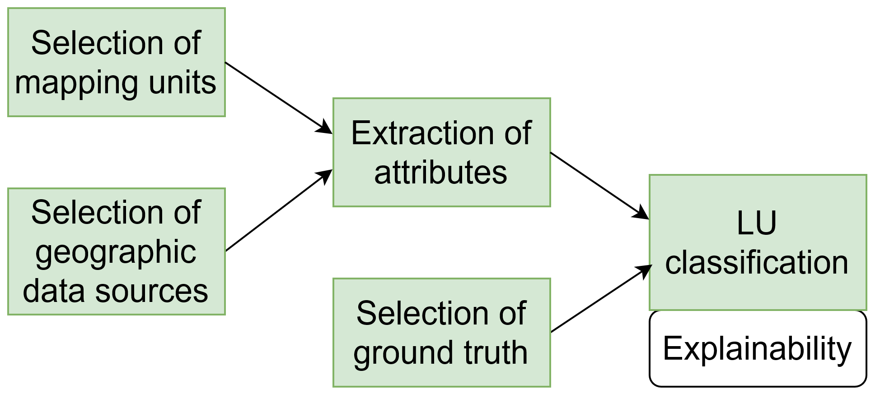
General LU classification workflow
Introduction
State of the art
LU classification
LU change detection
Conclusion
Notes:
First choose

Slide 22
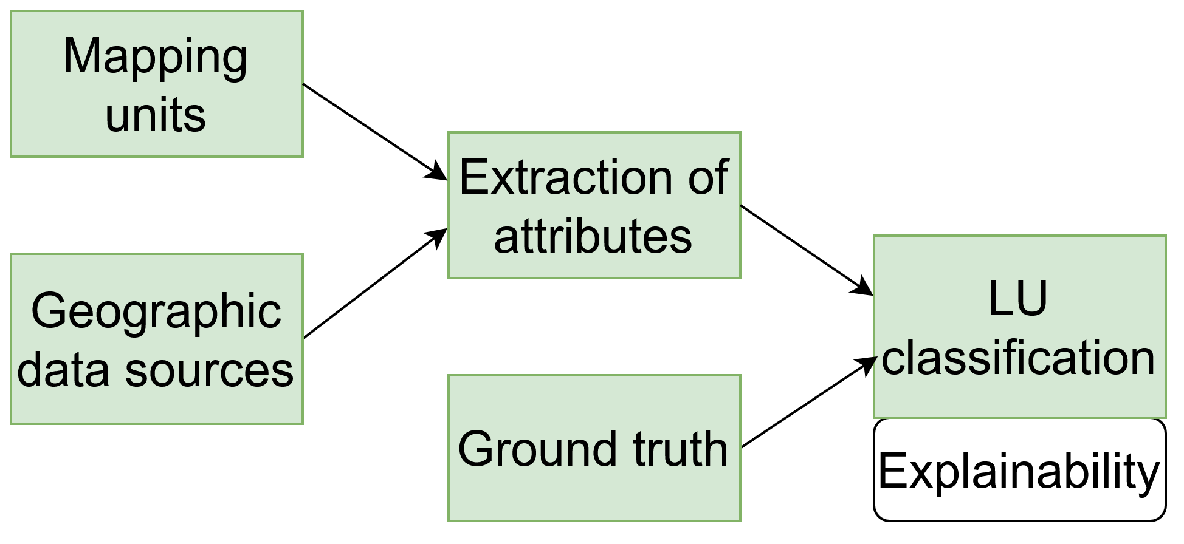
Selection of ground truth LU maps
Introduction
State of the art
LU classification
LU change detection
Conclusion
OCS GE LU maps produced by IGN:
INSPIRE compliant, interoperable with other European products
High resolution
High thematic precision
Strictly separate LU from LC
At least two vintages for each French department
Semi-automatic production
Notes:
High precision
Two vintages are available for each French department

Slide 23
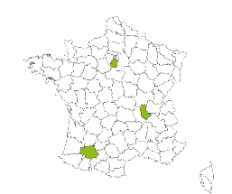
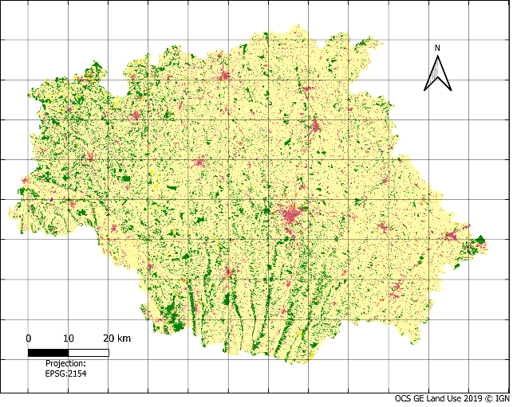
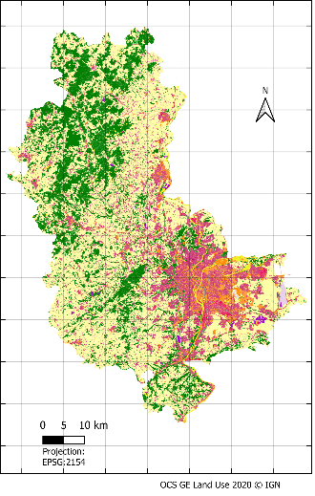
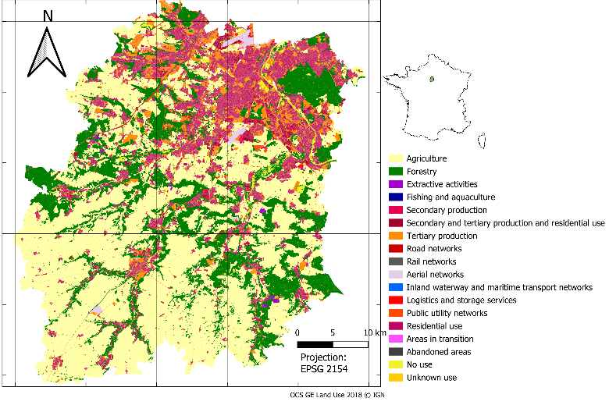
Selection of ground truth LU maps
Introduction
State of the art
LU classification
LU change detection
Conclusion
French departments of Gers (2019), Rhône (2020) and Essonne (2018 and 2021)
Heterogeneous study areas that present a diversity of rural and urban landscapes
Notes:
High precision
Two vintages are available for each French department

Slide 24
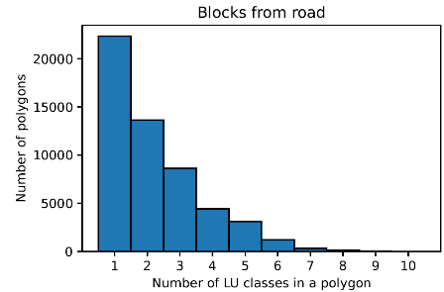
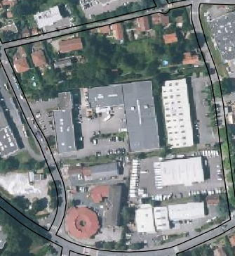
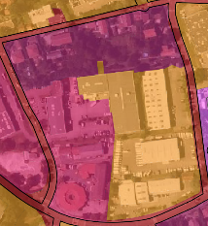
Selection of mapping units
Introduction
State of the art
LU classification
LU change detection
Conclusion
Crucial because of the Modifiable Areal Unit Problem (Openshaw, 1983)
Less precise mapping units → LU mix within the mapping units
→ Less thematically precise nomenclatures
OCS GE polygons → from main networks, cadastral parcels, and LC data
Majority LU class within the mapping unit

Slide 25
Selection of geographic data sources for LU classification
Introduction
State of the art
LU classification
LU change detection
Conclusion
Data sources that contain LU related information
Availability in France
FAIR principles (Findable, Accessible, Interoperable, Reusable) Wilkinson et al. (2016)

Slide 26
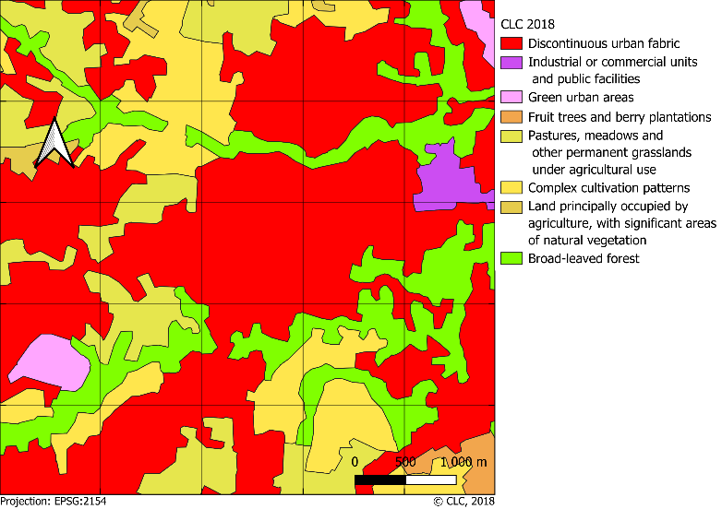

Selection of geographic data sources - CLC
Introduction
State of the art
LU classification
LU change detection
Conclusion
9 data sources of 6 types:
Land cover maps: CLC

Slide 27
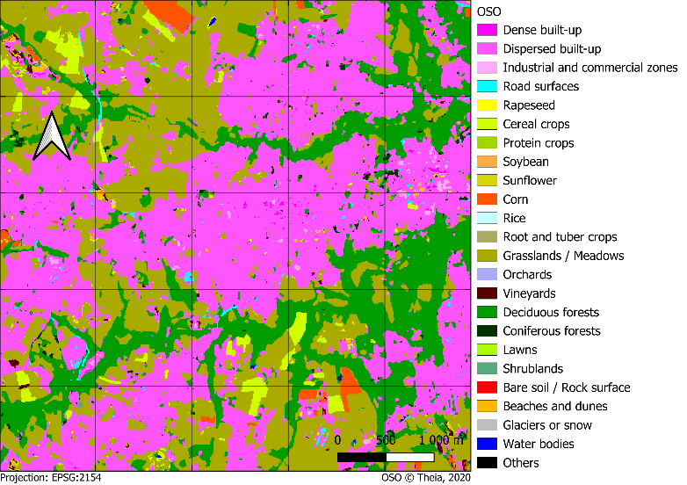


Selection of geographic data sources - OSO
Introduction
State of the art
LU classification
LU change detection
Conclusion
9 data sources of 6 types:
Land cover maps: CLC, OSO

Slide 28
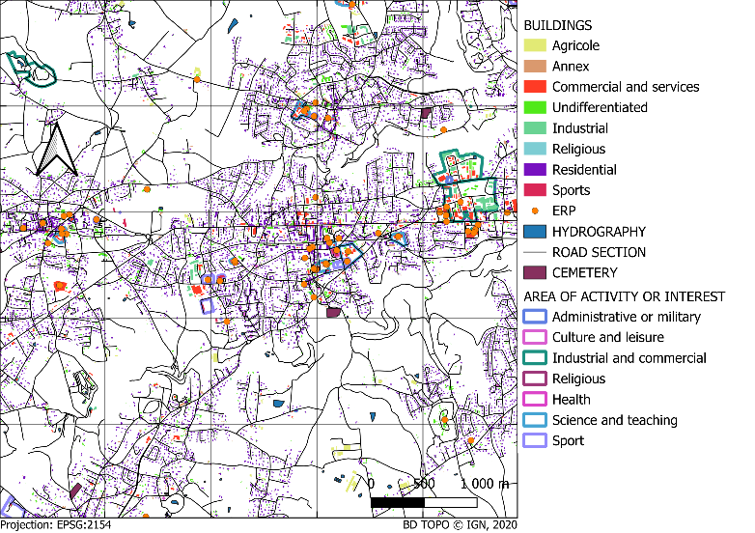

Selection of geographic data sources - BD TOPO
Introduction
State of the art
LU classification
LU change detection
Conclusion
9 data sources of 6 types:
Land cover maps: CLC, OSO
Topographic databases: BD TOPO

Slide 29
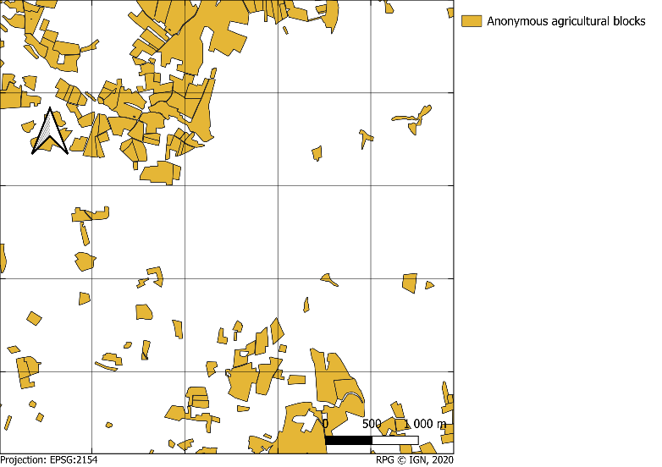

Selection of geographic data sources - RPG
Introduction
State of the art
LU classification
LU change detection
Conclusion
9 data sources of 6 types:
Land cover maps: CLC, OSO
Topographic databases: BD TOPO, RPG

Slide 30
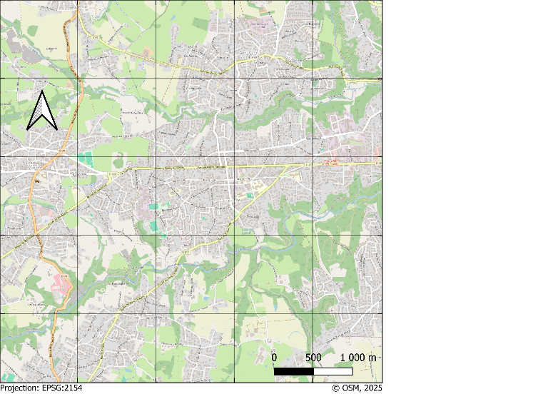

Selection of geographic data sources - OSM
Introduction
State of the art
LU classification
LU change detection
Conclusion
9 data sources of 6 types:
Land cover maps: CLC, OSO
Topographic databases: BD TOPO, RPG, OSM

Slide 31
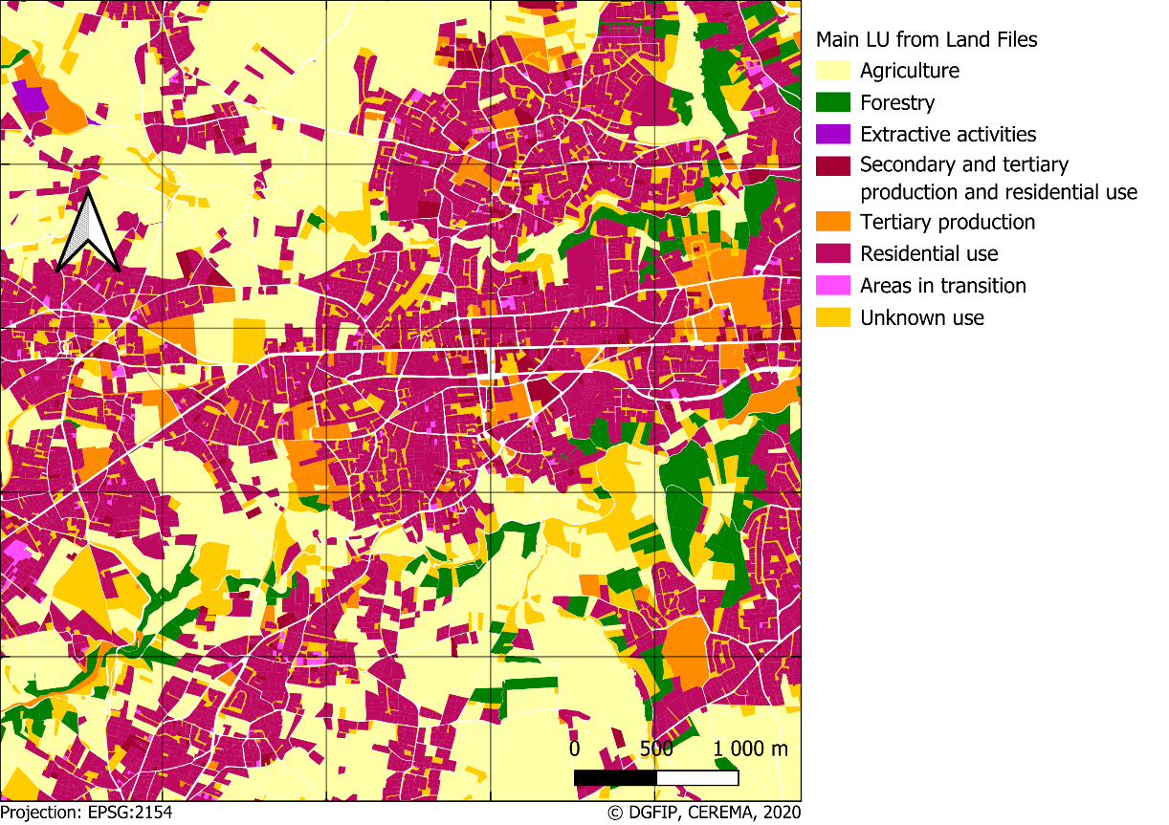





Selection of geographic data sources - Land Files
Introduction
State of the art
LU classification
LU change detection
Conclusion
9 data sources of 6 types:
Land cover maps: CLC, OSO
Topographic databases: BD TOPO, RPG, OSM
Cadastral data: Land Files

Slide 32
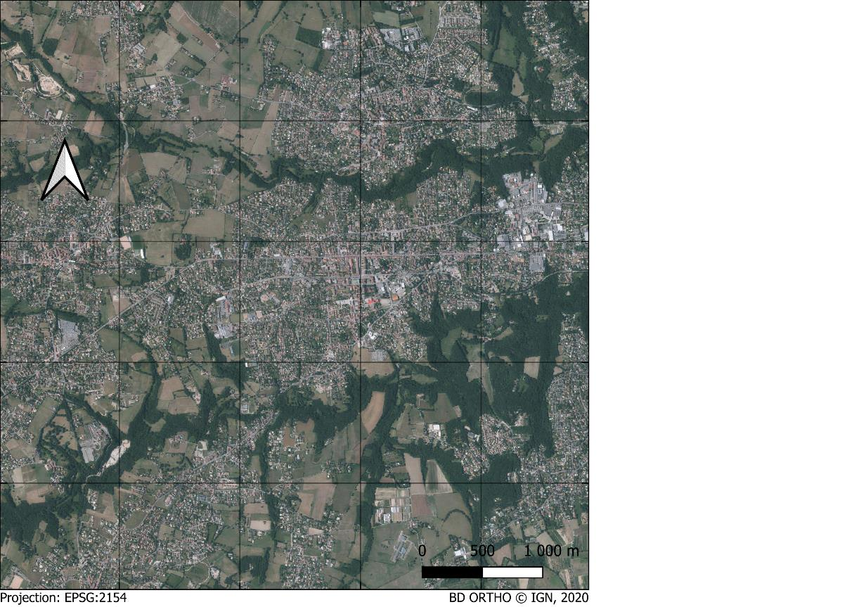

Selection of geographic data sources - BD ORTHO
Introduction
State of the art
LU classification
LU change detection
Conclusion
9 data sources of 6 types:
Land cover maps: CLC, OSO
Topographic databases: BD TOPO, RPG, OSM
Cadastral data: Land Files
Aerial images: BD Ortho

Slide 33
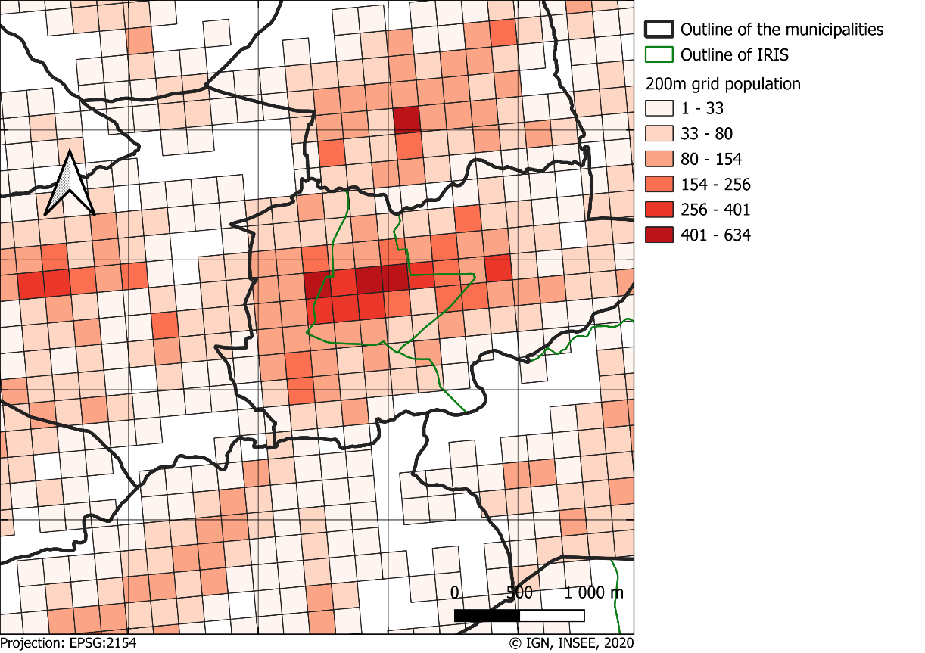

Selection of geographic data sources - INSEE
Introduction
State of the art
LU classification
LU change detection
Conclusion
9 data sources of 6 types:
Land cover maps: CLC, OSO
Topographic databases: BD TOPO, RPG, OSM
Cadastral data: Land Files
Aerial images: BD Ortho
Socio-demographic statistics: INSEE

Slide 34
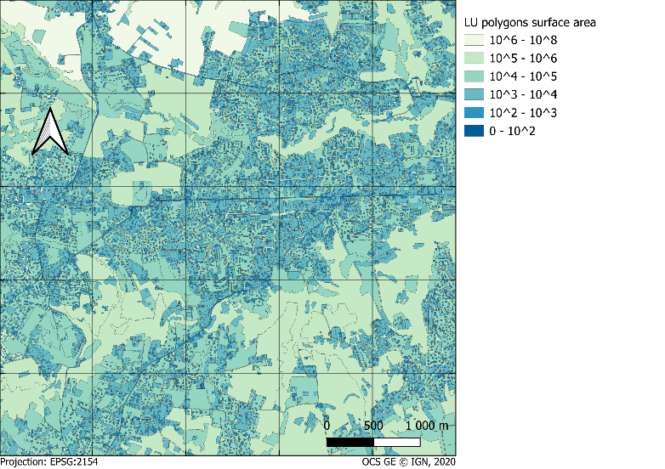




Selection of geographic data sources - Geometry
Introduction
State of the art
LU classification
LU change detection
Conclusion
9 data sources of 6 types:
Land cover maps: CLC, OSO
Topographic databases: BD TOPO, RPG, OSM
Cadastral data: Land Files
Aerial images: BD Ortho
Socio-demographic statistics: INSEE
Geometry of the mapping units

Slide 35
Extraction of attributes
Introduction
State of the art
LU classification
LU change detection
Conclusion
Several types of attributes depending on
the geometry of the data source
the data representation
the scale relationship with the mapping units
the explicitness of LU information
Formalized extraction process based on these types
Neighboring attributes
Hypotheses on their contribution to LU classification
quantitative qualitative (categorical)
"Number of residential buildings"
"Mean buildings height"

Slide 36
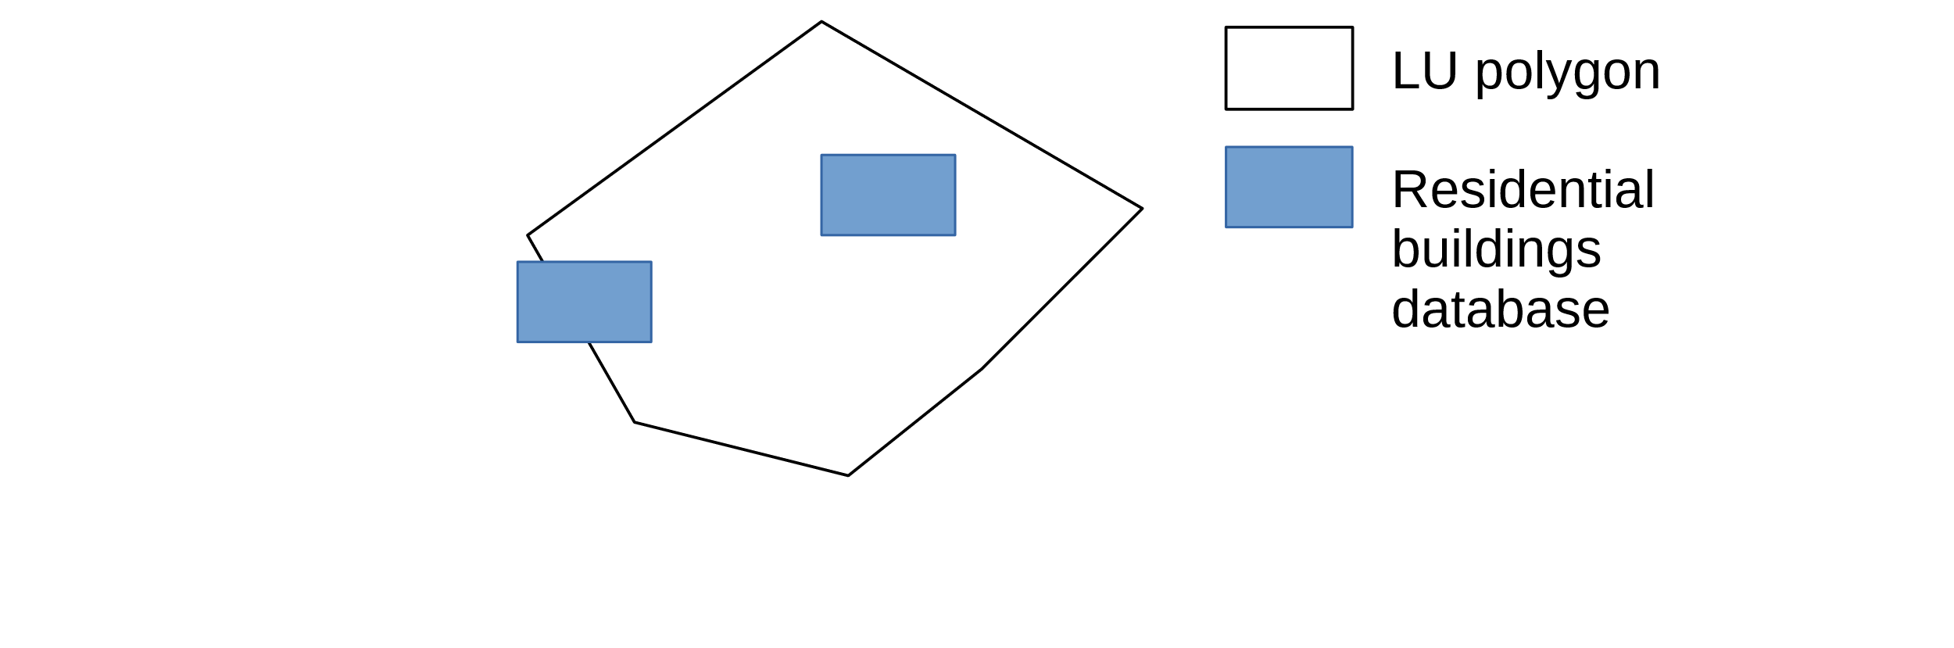
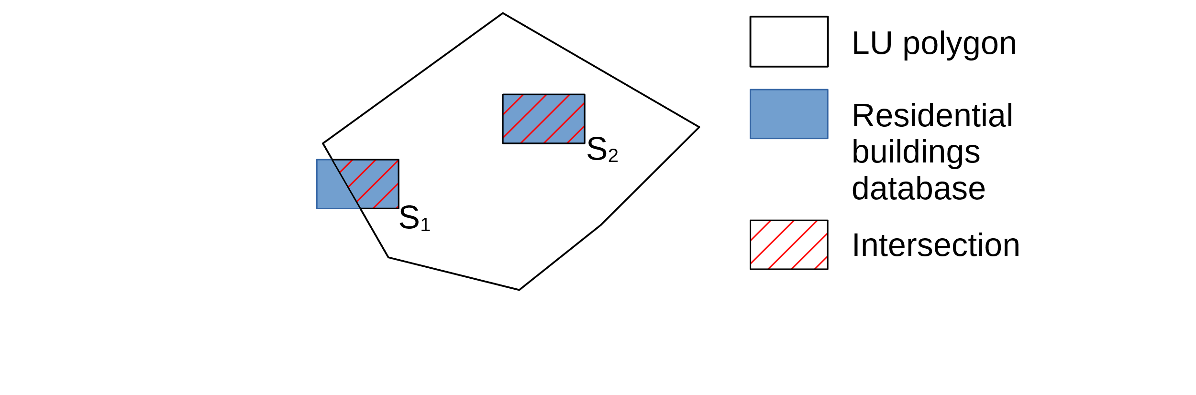
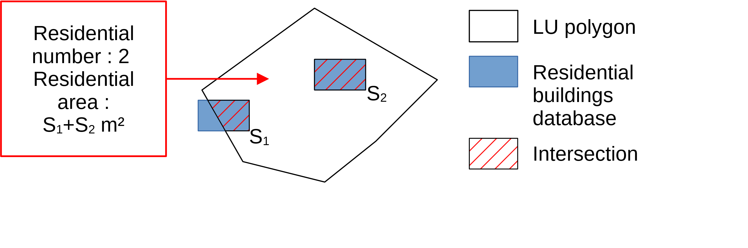
Extraction of attributes
Introduction
State of the art
LU classification
LU change detection
Conclusion

Slide 37
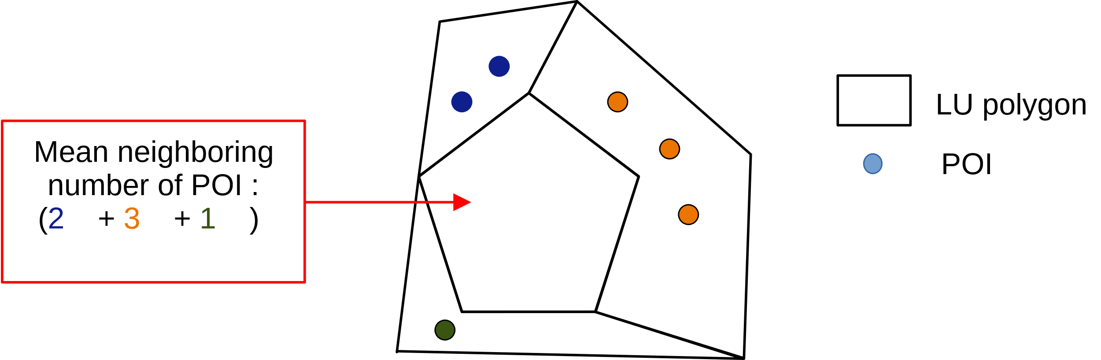
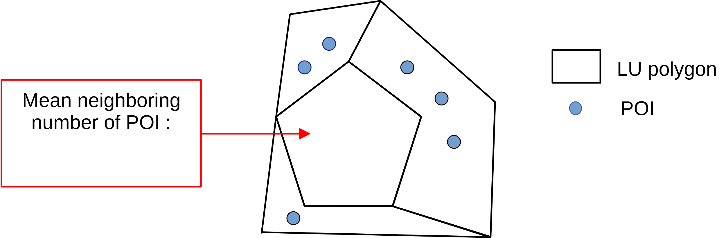
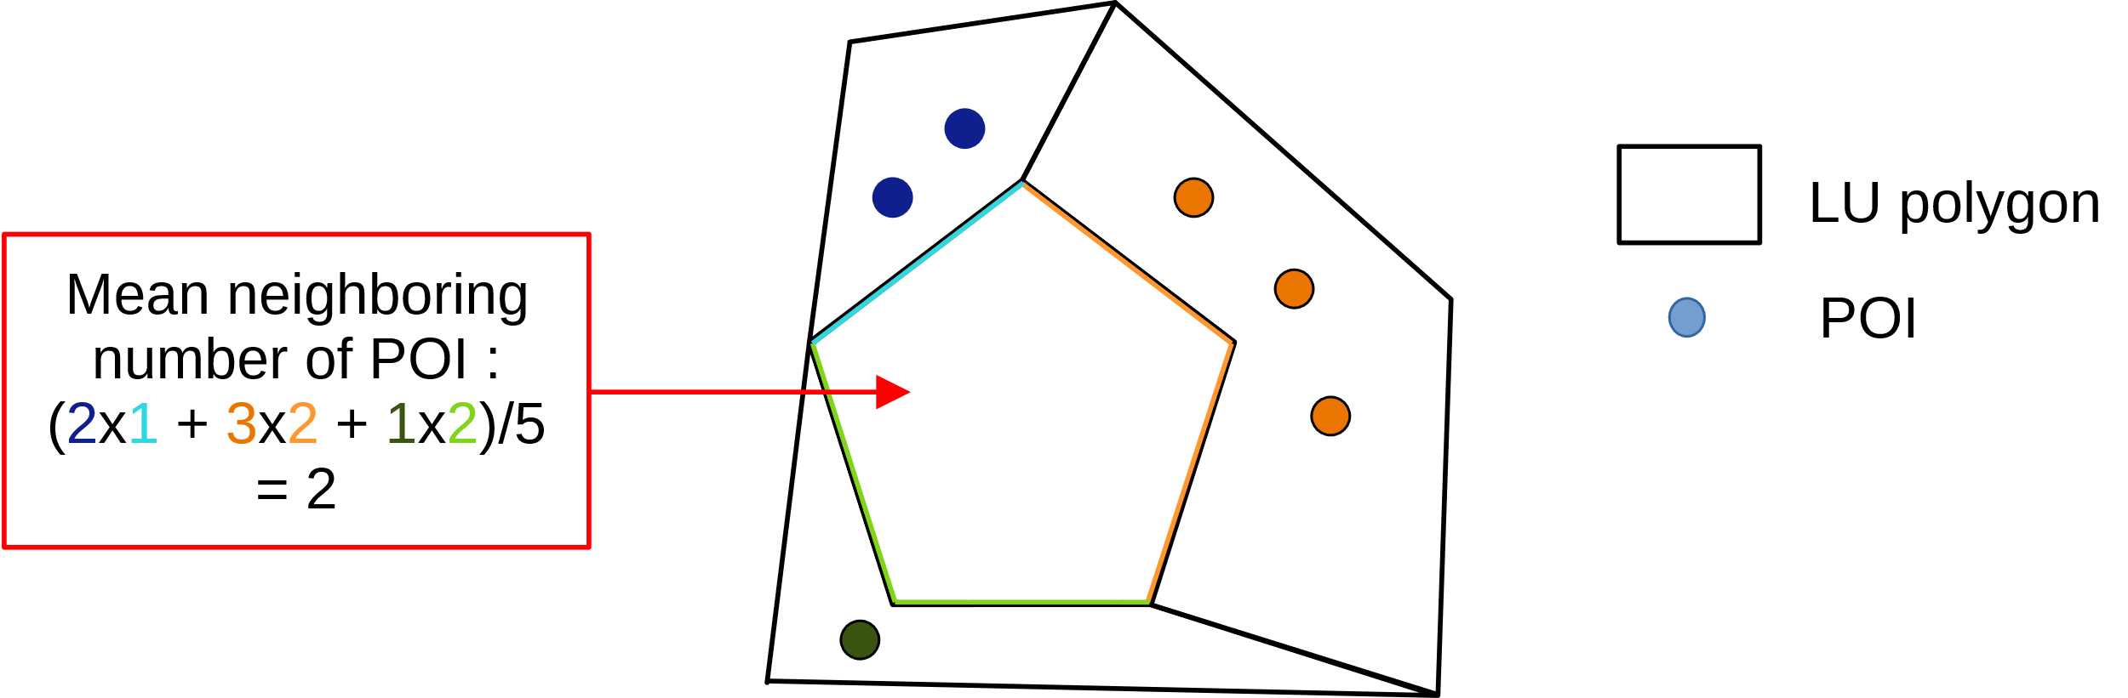
Extraction of attributes – neighboring attributes
Introduction
State of the art
LU classification
LU change detection
Conclusion

Slide 38
Extracted attributes
Introduction
State of the art
LU classification
LU change detection
Conclusion
Type | Source | Number of attributes | Neighboring attributes
LU segmentation | OCS GE LU geometry | 25 | 25
Optical imagery | BD ORTHO | 8 | 8
LC classification | CLC | 1 | 1
 | OSO | 1 | 1
Topographic database | BD TOPO buildings | 17 | 17
 | BD TOPO other | 13 | 13
 | RPG | 1 | 1
 | OpenStreetMap | 36 | 36
Demographic data | INSEE | 6 | 6
Land Files | DGFIP | 18 | 18
Total |  | 252

Slide 39
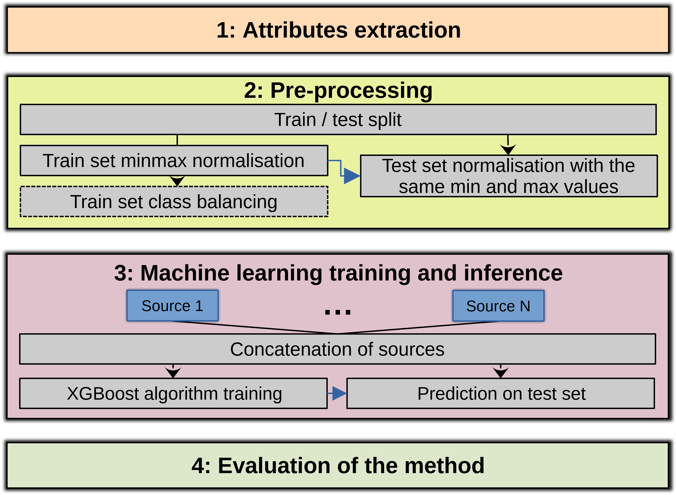
LU classification
Introduction
State of the art
LU classification
LU change detection
Conclusion
Class balancing by minority classes synthetic oversampling: SMOTE-NC algorithm (Chawla et al., 2014)
We showed in (Cubaud et al., 2023) that early fusion performed better than late fusion
XGBoost algorithm (Chen and Guestrin, 2016)
Spatial and temporal transferability experiments

Slide 40
Explainability
Introduction
State of the art
LU classification
LU change detection
Conclusion
How individual predictions are made?
Impact and interactions of the sources and attributes?
What information is used for each class?
Model improvement
Handling uncertainty
Error diagnosis
Trust and transparency
Helps decision making
Relevance of sources and attributes

Slide 41
Explainability
Introduction
State of the art
LU classification
LU change detection
Conclusion
3 complementary model-agnostic methods:
LA-1CO: Leave All minus one Covariate Out The model is trained and evaluated using only one data source.
Standalone relevance of each data source
LOCO (J. Lei et al., 2018): Leave One Covariate Out The model is trained and evaluated using all sources except one.
Added value and complementarity of the data sources
Notes:
We chose to these methods because they are model agnostic and provide numerous interesting and complementary insights but we have to keep in mind to interpret them the known flaws and biases of these methods

Slide 42
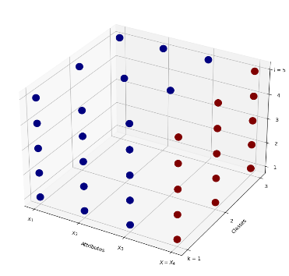
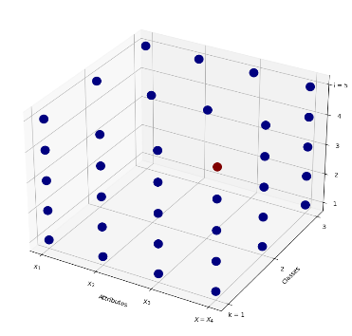
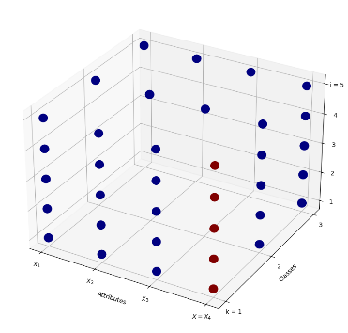
Explainability
Introduction
State of the art
LU classification
LU change detection
Conclusion
3 complementary model-agnostic methods:
SHAP (Lundberg & Lee, 2017): Shapley Additive exPlainations Quantifies the contribution of each attribute to the prediction of a class for a specific sample. → Local explanations (error diagnosis)
Aggregation for per-class and global importance of the attributes.
Polygons
Polygons
Polygons
SHAP(i, k, X)
Classes
Attributes
Classes
SHAP(X)
SHAP(k, X)

Slide 43
LU classification
Introduction
State of the art
LU classification
LU change detection
Conclusion
Results

Slide 44
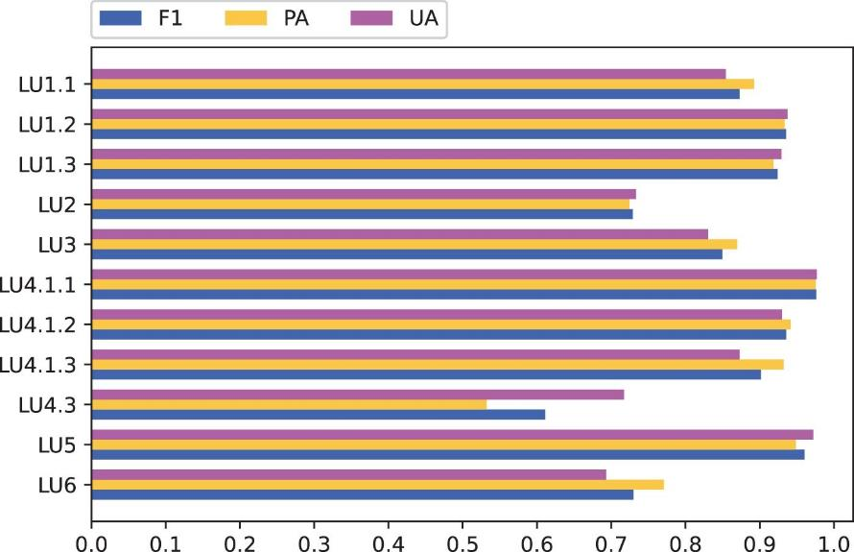
LU classification results
Introduction
State of the art
LU classification
LU change detection
Conclusion
Study dataset | mF1 | OA
Gers (2019) | 83% | 88%
Rhône (2020) | 86% | 92%
Essonne (2018) | 85% | 94%
Essonne (2021) | 81% | 93%
Agriculture
Forestry
Extractive activities
Secondary production
Tertiary production
Road transport
Railway transport
Air transport
Public utility networks
Residential
Other
Road Transport (LU4.1.1): F1= 94%
Public utility networks (LU4.3): F1= 61%
Metrics per class for the Rhône dataset

Slide 45
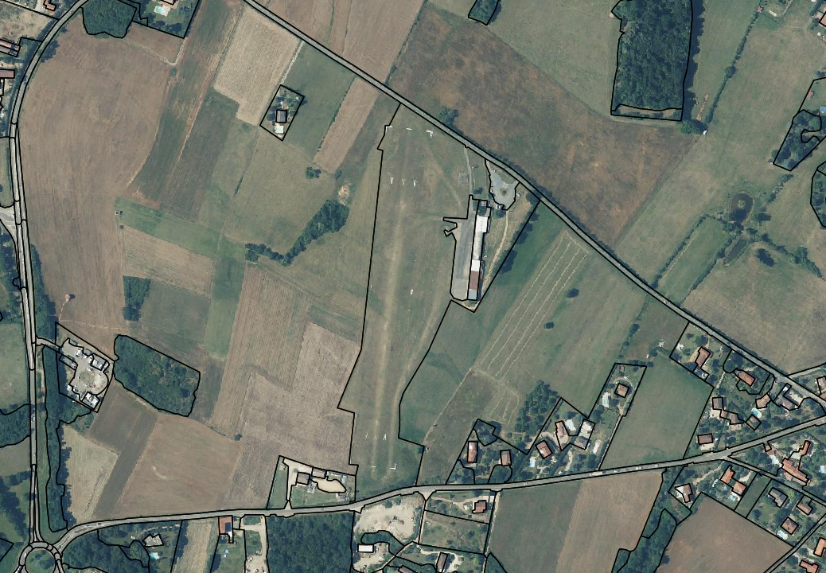
Example of a misclassification
Introduction
State of the art
LU classification
LU change detection
Conclusion
Aerodrome of Lyon – Brindas
Predicted tertiary production (LU3) instead of air transport (LU4.1.3)
BD Ortho, OCSGE © IGN

Slide 46
Example of a misclassification
Introduction
State of the art
LU classification
LU change detection
Conclusion
Aerodrome of Lyon – Brindas
Predicted tertiary production (LU3) instead of air transport (LU4.1.3)
Information given by the sources:
Aerodrome in BD TOPO and OSM
Undifferentiated buildings in BD TOPO and one commercial building
In land files the area is considered as tertiary
BD Ortho, OCSGE © IGN

Slide 47


Example of a misclassification
Introduction
State of the art
LU classification
LU change detection
Conclusion
Polygon Aerodrome of Lyon – Brindas
True class : Air transport (LU4.1.3)
Badly predicted class : Tertiary production (LU3)

Slide 48
Example of a misclassification
Introduction
State of the art
LU classification
LU change detection
Conclusion
Polygon Aerodrome of Lyon – Brindas
True class : Air transport (LU4.1.3)
Badly predicted class : Tertiary production (LU3)

Slide 49
Example of a misclassification
Introduction
State of the art
LU classification
LU change detection
Conclusion
Polygon Aerodrome of Lyon – Brindas
True class : Air transport (LU4.1.3)
Badly predicted class : Tertiary production (LU3)
Base probability LU4.1.3 = 0.08%
Base logits LU4.1.3 = -4.71
Base probability LU3 = 13.1%
Base logits LU3 = 0.36
log(p) +cst

Slide 50


Example of a misclassification
Introduction
State of the art
LU classification
LU change detection
Conclusion
Polygon Aerodrome of Lyon – Brindas
True class : Air transport (LU4.1.3)
Badly predicted class : Tertiary production (LU3)
Base probability LU4.1.3 = 0.08%
Base logits LU4.1.3 = -4.71
$\sum_{X}{\text{SHAP}\text{(}\text{aerodrome}\text{, }\text{LU}\text{4.1.3, }\text{X}\text{)}}$= 2.19
Base probability LU3 = 13.1%
Base logits LU3 = 0.36
$\sum_{X}{\text{SHAP}\text{(}\text{aerodrome}\text{, }\text{LU}\text{3, }\text{X}\text{)}}$= 1.35
log(p) +cst

Slide 51


Example of a misclassification
Introduction
State of the art
LU classification
LU change detection
Conclusion
Polygon Aerodrome of Lyon – Brindas
True class : Air transport (LU4.1.3)
Badly predicted class : Tertiary production (LU3)
Base probability LU4.1.3 = 0.08%
Base logits LU4.1.3 = -4.71
$\sum_{X}{\text{SHAP}\text{(}\text{aerodrome}\text{, }\text{LU}\text{4.1.3, }\text{X}\text{)}}$= 2.19
Final logits = -2.59
Probability LU4.1.3 = 1.31%
Base probability LU3 = 13.1%
Base logits LU3 = 0.36
$\sum_{X}{\text{SHAP}\text{(}\text{aerodrome}\text{, }\text{LU}\text{3, }\text{X}\text{)}}$= 1.35
Final logits = 1.71
Probability LU3 = 91%
log(p) +cst
softmax

Slide 52

Link between attributes and classes
Introduction
State of the art
LU classification
LU change detection
Conclusion
Links between the 15 most important attributes and the LU classes
Notes:
Links between the 15 most important attributes and the LU classes

Slide 53
Link between attributes and classes
Introduction
State of the art
LU classification
LU change detection
Conclusion
Links between the 15 most important attributes and the LU classes
Notes:
Links between the 15 most important attributes and the LU classes

Slide 54
Link between attributes and classes
Introduction
State of the art
LU classification
LU change detection
Conclusion
All the sources have at least one attribute among the 50 most important attributes
→ usefulness of multi source classification
Notes:
Links between the 15 most important attributes and the LU classes

Slide 55


LU classification results
Introduction
State of the art
LU classification
LU change detection
Conclusion
Study dataset | mF1
Gers (2019) | 83%
Rhône (2020) | 86%
Essonne (2018) | 85%
Essonne (2021) | 81%
Individual study area classification
Study dataset | mF1
Gers to Rhône | 50%
Rhône to Gers | 51%
Essonne 2018 to 2021 | 75%
Essonne 2021 to 2018 | 80%
Transferability

Slide 56

Transferability from Gers to Rhône
Introduction
State of the art
LU classification
LU change detection
Conclusion

Slide 57



LU classification results
Introduction
State of the art
LU classification
LU change detection
Conclusion
Study dataset | mF1
Gers (2019) | 83%
Rhône (2020) | 86%
Essonne (2018) | 85%
Essonne (2021) | 81%
Individual study area classification
Study dataset | mF1
Gers to Rhône | 50%
Rhône to Gers | 51%
Essonne 2018 to 2021 | 75%
Essonne 2021 to 2018 | 80%
Transferability
Study dataset | mF1
Gers to Rhône | 70%
Rhône to Gers | 79%
Essonne 2018 to 2021 | 88%
Essonne 2021 to 2018 | 88%
Mixed train set transferability (80% of origin dataset and 5% of target dataset)

Slide 58
LU change detection
Introduction
State of the art
LU classification
LU change detection
Conclusion
Methodology

Slide 59
State of the art – Change detection
Introduction
State of the art
LU classification
LU change detection
Conclusion
Mostly remote-sensing-based LC change detection (Gonthier, 2025)
CNN-based models
Often Siamese Embedding-level fusion architectures (Daudt et al., 2018)
LU change detection remains mostly unstudied
Difficulties:
heterogeneity and rarity of LU changes
heterogeneous multi-source change detection
semantic and geometric changes
C. Cao et al. (2019), Olteanu-Raimond et al. (2020), L. Liu et al. (2021), Yao et al. (2023), S. Shi et al. (2025), Fang et al. (2025)
Lack of a high quality LU change ground truth

Slide 60

General LU change detection workflow
Introduction
State of the art
LU classification
LU change detection
Conclusion
Context of the update of an LU map
Same steps as in LU classification

Slide 61


Construction of a LU change ground truth
Introduction
State of the art
LU classification
LU change detection
Conclusion
Create a ground truth of the t_{i} polygons that change their LU:
Semantic changes
Geometric changes
LU t_{i}
LU t_{i+1}

Slide 62

Construction of a LU change ground truth
Introduction
State of the art
LU classification
LU change detection
Conclusion
Intersection between the two GT LU maps

Slide 63

Construction of a LU change ground truth
Introduction
State of the art
LU classification
LU change detection
Conclusion
Intersection between the two GT LU maps
LU change of the intersection polygons

Slide 64


Construction of a LU change ground truth
Introduction
State of the art
LU classification
LU change detection
Conclusion
Intersection between the two GT LU maps
LU change of the intersection polygons
Type of geometric change
(Thériault & Claramunt, 1999)

Slide 65


Construction of a LU change ground truth
Introduction
State of the art
LU classification
LU change detection
Conclusion
Intersection between the two GT LU maps
LU change of the intersection polygons
Type of geometric change
Changing t_{i} polygons

Slide 66

Construction of a LU change ground truth
Introduction
State of the art
LU classification
LU change detection
Conclusion
Intersection between the two GT LU maps
LU change of the intersection polygons
Type of geometric change
Changing t_{i} polygons
Manual verifications and corrections

Slide 67


Construction of a LU change ground truth
Introduction
State of the art
LU classification
LU change detection
Conclusion
Example of correction
LU6.3 Without use
Verification of 816 polygons
"LU change, no geometric change"
LU4.1.2 Railway transport
Modification of 668 of them
Actually no LU change

Slide 68
LU change ground truth of Essonne between 2018 and 2021
Introduction
State of the art
LU classification
LU change detection
Conclusion
Polygons | Changed LU | Did not changed LU
Number | 3,926 | 197,163
Percentage | 2% | 98%
81% change LC
19% did not change LC
54% of LC changes are not LU changes
In terms of surface area, a larger proportion (22%) of the study area has changed LU ↑ large polygons of which only a small part changed

Slide 69




Example of LU change dilution
Introduction
State of the art
LU classification
LU change detection
Conclusion
Tertiary production
Agriculture
Agriculture

Slide 70

How LU classes evolved between 2018 and 2021?
Introduction
State of the art
LU classification
LU change detection
Conclusion
2018 LU Class
2021 LU Class
A large number of pairs of LU classes
Some are very rare
Mixed LU resulting from the use of t_{i} mapping units
These mixed LU are also very heterogeneous
Makes learning LU changes very difficult

Slide 71
LU change detection
Introduction
State of the art
LU classification
LU change detection
Conclusion
Goal: Detect t_{i} mapping units which LU have change
Inputs: attributes extracted from the data sources at t_{i} and t_{i+1} in the t_{i} mapping units.

Slide 72



LU change detection
Introduction
State of the art
LU classification
LU change detection
Conclusion
3 possible data fusion approaches for the attributes of the two dates:
Post-classification
Embedding-level fusion
Early fusion

Slide 73
LU change detection
Introduction
State of the art
LU classification
LU change detection
Conclusion
Results

Slide 74
LU change detection results
Introduction
State of the art
LU classification
LU change detection
Conclusion
Post classification approach: mF1=56%, F1_{change}=18%
Accurate but not perfect LU classification → numerous false detections of LU changes

Slide 75

LU change detection results
Introduction
State of the art
LU classification
LU change detection
Conclusion
Embedding level fusion approach: mF1=67%, F1_{change}=35%
Adding LU classification constraints: mF1=70%, F1_{change}=41%

Slide 76
LU change detection results
Introduction
State of the art
LU classification
LU change detection
Conclusion
Early fusion approach: mF1=74%, F1_{change}=49%
45% of the LU changes are detected
55% of the detections are real LU changes

Slide 77



LU change detection examples
Introduction
State of the art
LU classification
LU change detection
Conclusion
t_{i} (2018)
Accurate change detection
t_{i+1} (2021)
LU5: Residential, LU4.1.1: Road Transport
Detected polygon
Geometric change

Slide 78


LU change detection examples
Introduction
State of the art
LU classification
LU change detection
Conclusion
t_{i} (2018)
False detection
t_{i+1} (2021)
LU5: Residential
Detected polygon
Geometric change

Slide 79
Conclusion
Introduction
State of the art
LU classification
LU change detection
Conclusion

Slide 80
Contributions
Introduction
State of the art
LU classification
LU change detection
Conclusion
Formalization of the extraction of attributes from data sources containing LU information
General workflow for LU classification
Formalization of LU changes (semantic + geometric changes)
Comparison of approaches for LU change detection
Explainability methodology applied to LU classification and change detection
Publication of datasets to serve as benchmark for LU classification
Formalization of the extraction of attributes from data sources containing LU information
General workflow for LU classification
Formalization of LU changes (semantic + geometric changes)
Comparison of approaches for LU change detection
Explainability methodology applied to LU classification and change detection

Slide 81
Publications
Introduction
State of the art
LU classification
LU change detection
Conclusion
Journal
Cubaud, M., Le Bris, A., Jolivet, L., and Olteanu-Raimond, A. M. (2024). Assessing the transferability of a multi-source land use classification workflow across two heterogeneous urban and rural areas. International Journal of Digital Earth, 17(1). https://doi.org/10.1080/17538947.2024.2376274
International conferences
Cubaud, M., Le Bris, A., Jolivet, L., and Olteanu-Raimond, A.-M. (2023). Comparison of two data fusion approaches for land use classification, Int. Arch. Photogramm. Remote Sens. Spatial Inf. Sci., XLVIII-1/W2-2023, 699–706, https://doi.org/10.5194/isprs-archives-XLVIII-1-W2-2023-699-2023, 2023.
Cubaud, M., Le Bris, A., Jolivet, L., and Olteanu-Raimond, A. M. (2025). Interpretability of a multi-source Land Use classification machine learning model using a SHAP approach, International Conference on Spatial Analysis and GEOmatics (SAGEO 2025)
Future publications
Cubaud, M., Olteanu-Raimond, A-M., Fonte, C., Duarte, D., Estima, J., See, L., Gonthier, N., Jolivet, L., Mallet, C., Le Bris, A., Vyron, A.: OntoLULC-SOTA: An ontology based approach to make systematic reviews for LULC data, ISPRS 2026 (submitted)
Datasets
Cubaud, M., Le Bris, A., Jolivet, L., Olteanu-Raimond, A.-M., & Institut national de l'information géographique et forestière. (2024). OCS GE Land Use dataset including the French departments of Gers and Rhône. Zenodo. https://doi.org/10.5281/zenodo.10462844
Code
https://github.com/mcubaud/multi-source-Land-Use-classification

Slide 82
Perspectives
Introduction
State of the art
LU classification
LU change detection
Conclusion
Better integration of remote sensing information
Classification of mixed LU
Improving LU change detection ground truths
Extension of the methodology to other products

Slide 83
Perspectives
Introduction
State of the art
LU classification
LU change detection
Conclusion
Better integration of remote sensing information
Classification of mixed LU
Improving LU change detection ground truths
Extension of the methodology to other products

Slide 84
Improve LU change detection ground truths
Introduction
State of the art
LU classification
LU change detection
Conclusion
Using crowdsourcing campaigns to validate LU changes (L. Liu et al., 2021)
Using automatic label noise detection approaches (Liang et al., 2022)
Increasing the variety by using several study areas or by generating synthetic changes (Benidir et al., 2025)

Slide 85
Perspectives
Introduction
State of the art
LU classification
LU change detection
Conclusion
Better integration of remote sensing information
Improving LU change detection ground truths
Classification of mixed LU
Extension of the methodology to other products

Slide 86


Better integration of remote sensing information
Introduction
State of the art
LU classification
LU change detection
Conclusion
FLAIR (Garioud et al., 2022) U-Net trained for LC
Raster LC
Classification
Fine tune for LU classification or LU change detection
Encoder
Decoder
Intersection with LU mapping units
Extraction of attributes for LU classification or LU change detection
Feature maps

Slide 87
Perspectives
Introduction
State of the art
LU classification
LU change detection
Conclusion
Better integration of remote sensing information
Extension of the methodology to other products
Classification of mixed LU
Improving LU change detection ground truths

Slide 88

Extension of the methodology to other products
Introduction
State of the art
LU classification
LU change detection
Conclusion
Urban Atlas

Slide 89
Perspectives
Introduction
State of the art
LU classification
LU change detection
Conclusion
Better integration of remote sensing information
Extension of the methodology to other products
Classification of mixed LU
Improving LU change detection ground truths

Slide 90


Classification of mixed LU
Introduction
State of the art
LU classification
LU change detection
Conclusion
Different types of LU mix
Limit to the hypothesis of a majority LU
No existing mixed LU dataset in France
Creation of synthetic datasets?
©panoramax
Horizontal mix
Vertical mix
On the same place

Slide 91
Publications
Introduction
State of the art
LU classification
LU change detection
Conclusion
Thank you for your attention!

